Slide 1


Java Programming Workshop (Concurrent Programming Experiments)
Mr. Dheeraj Kumar Singh, Assistant Professor
Information Technology Department, PIET

Slide 2


Experiment-8
Program to demonstrate thread using Thread class and Runnable interface.

Slide 3
Aim: Write a program to demonstrate thread using Thread class and Runnable interface.
Objectives: To Explain Concurrent Programming using Thread Programs in JAVA.
Apparatus/Components: JDK,JRE,JVM, Notepad/Notepad++, Net Beans, Eclipse Software, Online Compiler

Slide 4

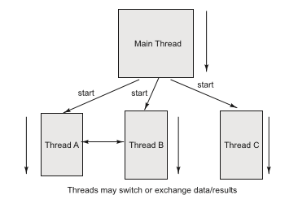

Theory/Concepts
Concurrency: The execution of two or more tasks in overlapping time periods that are not necessarily simultaneous.
Concurrency can be achieved using threads. Java provides in built support for multithreading.
Image source : Google

Slide 5
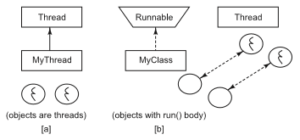
Theory/Concepts
• We can define a thread in following ways:
[a] By extending Thread class
[b] By implementing Runnable interface
Image source : Google

Slide 6
DEFINING THREAD BY EXTENDING THREAD CLASS
Step 1: Create a class by extending Thread class and override the run() method:
class MyThread extends Thread
{
public void run() {
// thread body of execution
}
}
Step 2: Create a thread object:
MyThread t = new MyThread();
Step 3: Start Execution of created thread:
t.start();

Slide 7
DEFINING THREAD BY EXTENDING THREAD CLASS
EXAMPLE:
class ThreadDemo {
public static void main(String[] args) {
MyThread t=new MyThread(); //Instantiation of a Thread
t.start(); //starting of a Thread
for(int i=0;i<5;i++) {
System.out.println("main thread");
}
}
}

Slide 8
DEFINING THREAD BY IMPLEMENTING RUNNABLE INTERFACE
Step 1: Create a class that implements the interface Runnable and override run() method:
class MyRunnable implements Runnable { …
public void run() {
// thread body of execution
}
}
Step 2: Creating Object:
MyRunnable myObject = new MyRunnable ();
Step 3: Creating Thread Object:
Thread t = new Thread(myObject);
Step 4: Start Execution:
t.start();

Slide 9
DEFINING THREAD BY IMPLEMENTING RUNNABLE INTERFACE
EXAMPLE:
class ThreadDemo {
public static void main(String[] args){
MyRunnable myObject =new MyRunnable();
Thread t=new Thread(myObject);
//here myObject is a Target Runnable t.start();
for(int i=0;i<10;i++) {
System.out.println("main thread");}
}
}

Slide 10
Procedure
Step 1: Open an editor (notepad).
Step 2: Write the Program.
Step 3: Save the file with .java extension.
Step 4: Open cmd to execute your Program.
Step 5: Compile java file to generate class file using javac command.
Step 6: Run the program using java command.
Step 7: Check output.

Slide 11
Experiment Demonstration

